Slide 1



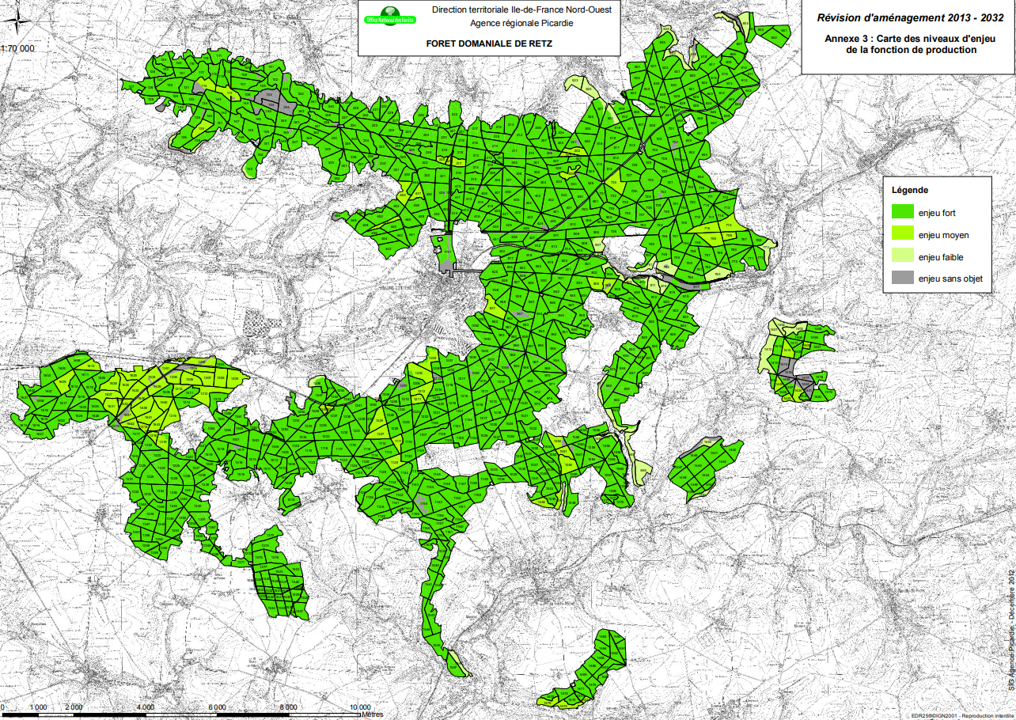
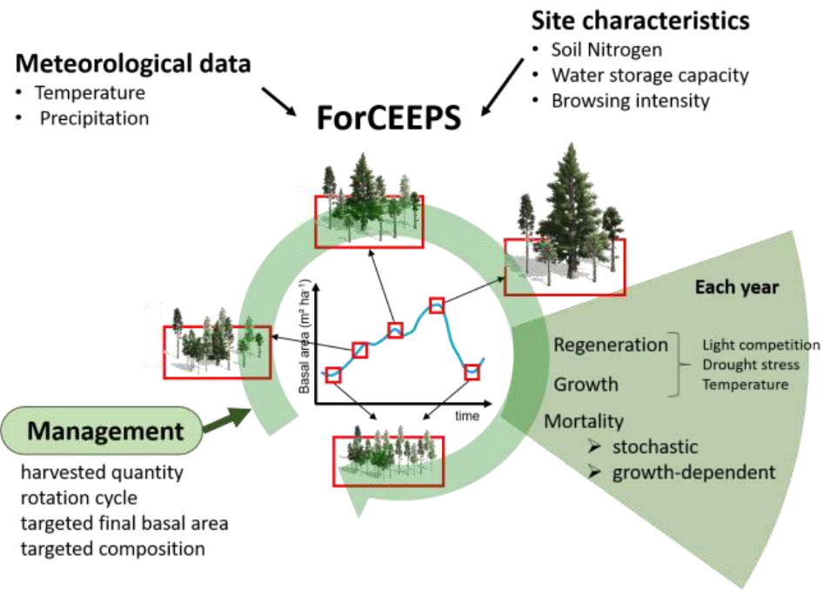
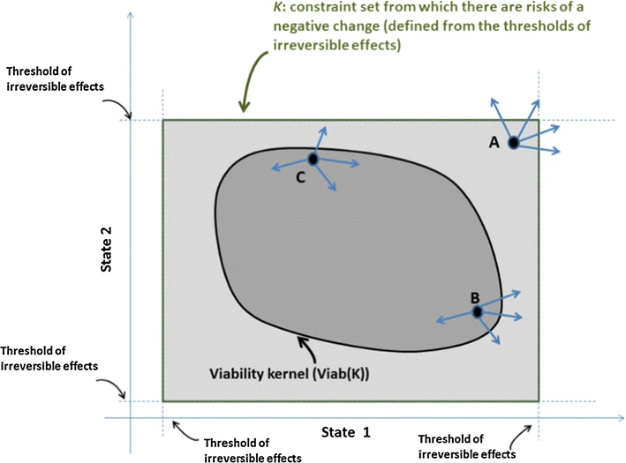
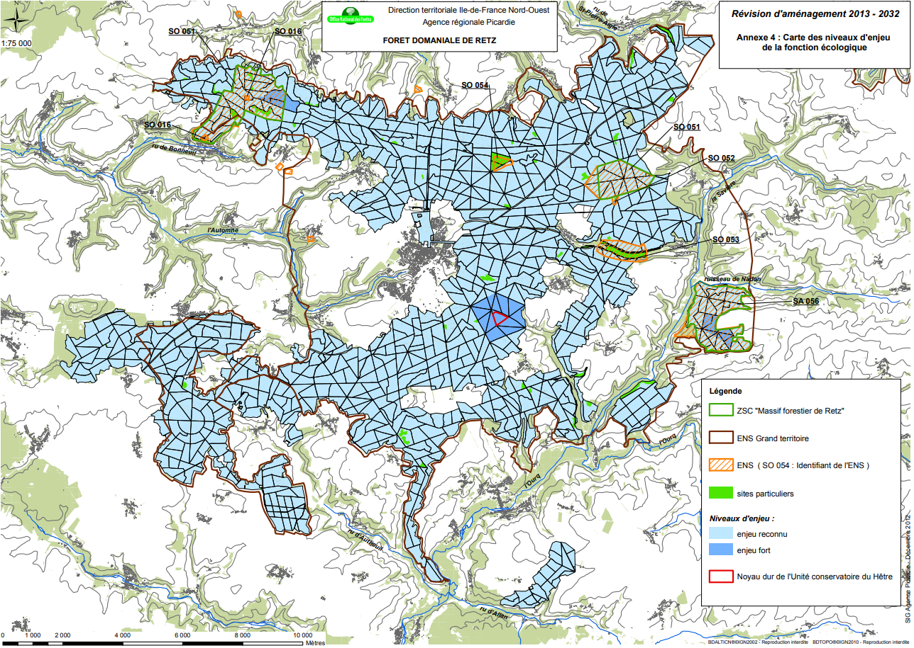
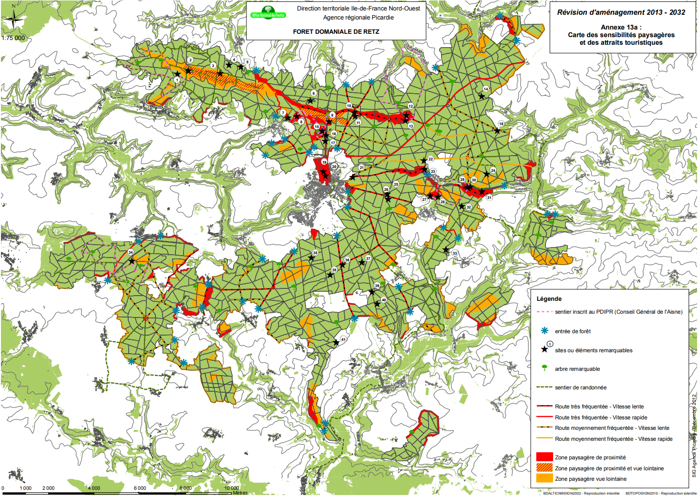
Planning multi-functional forest management at the landscape scale
Laboratoire d’ingénierie pour les systèmes complexes
Ecole doctorale Sciences Pour l’Ingénieur
Clémentine de Montgolfier
Jean-Denis Mathias (LISC), Jean-Baptiste Pichancourt (LISC), Marion Jourdan (SILVA)
Introduction
Managing multi-functional forests— for timber, carbon storage, and biodiversity—requires planning at both the stand and landscape scales. While stand-level management can enhance local biodiversity, it may lead to homogenization across the landscape, reducing habitat diversity and increasing vulnerability to disturbances [1]. Landscape-scale approaches are better suited to address these broader ecological dynamics and support more resilient forest systems [2].
However, implementing effective landscape-scale planning is complex. It involves not only deciding what management actions to take but also where to apply them across heterogeneous forested areas.
To address these challenges, innovative tools from complex systems dynamics and control theory are needed. These methods can help explore a broad set of planning strategies that account for spatial structure, trade-offs, and the need for multi-functionality in forest landscapes..
Beech Conservation Unit
Method developpement
Forest functions
Wood production
Challenges
Map of priority levels for the production function
The complexity of terrain and ecosystems across large landscapes presents significant challenges for management methods, including:
Modeling ecosystems accurately at broad spatial scales
Managing the computational complexity due to a large number of possible management actions
Meeting multiple, often conflicting constraints simultaneously
Adaptability of tools for different use (limit of optimality)
Priority
High
Medium
Low
None
Goals
[6.]
Biodiversity and habitat
Map of priority levels for the ecological function
[7.]
Special area of conservation
Viability theory framework
Sensitive natural area (ENS)
[4.]
specific site
Priority
Medium
High
Extend the mechanistic forest model ForCEEPS to predict dynamics at the forest scale
Apply viability theory to formulate forest management as a control problem under multiple constraints
Beech Conservation Unit
[6.]
Social utility
Map of Landscape Sensitivities and Tourist Attractions
Conclusion
Managing forests at the landscape scale is challenging due to the complexity of ecosystems, the diversity of services they provide, and the need to balance production, biodiversity, social demands, and climate adaptation.
New tools like control theory can help by revealing system dynamics and offering flexible pathways, allowing managers to adapt strategies to their local context [4].
To make this possible, new governance structures will be needed—ones that support collaboration and long-term planning across scales [5].
Trail registered in the PDIPR
Forest access point
Bibliography
Remarkable site
Remarkable tree
Hiking trail
Heinrichs, S., et al. (2019). Landscape-scale tree mixtures benefit plant and lichen biodiversity. Forests, 10(1), 73.
Duflot, R., Fahrig, L., Mönkkönen, M. (2022). Management diversity promotes biodiversity in production forests. Biol. Conserv., 268, 109514.
Morin, X., Bugmann, H., de Coligny, F., et al. (2021). A gap model for ecosystem function and tree composition under climate change. Funct. Ecol., 35(4), 955–975.
Mathias, J.-D., Bonté, B., et al. (2015). Viability theory and forest management flexibility. Environ. Manage., 56(5), 1170–1183.
Pichancourt, J.-B., Brias, A., Bonis, A. (2025). Integrating adaptation pathways and Ostrom’s framework for sustainable governance of social-ecological systems in a changing world.
ONF (Office National des Forêts). Plan d’aménagement forestier de la forêt domaniale de Retz 2013–2032.
Jourdan, M. (2018). Le rôle de la diversité sur la stabilité des processus des écosystèmes forestiers en contexte de changement climatique. Thèse de doctorat, AgroParisTech. ffNNT : 2018AGPT0009ff.
High-traffic roads
Moderate-traffic roads
Heavily Visited Landscape Area
[6.]
Both visited and distant view
Distant View Landscape Area
The maps reveal the spatial complexity of forest management challenges.
Diverse functions and goals to address
Uneven spatial scales: some very local, others global
Overlapping zones, potential hotspots for conflict
Order online at https://www.postersession.com/order/

